Slide 1
Software Engineering (SR, Testing)
Subject Code: INFO 3104
Book: Fundamentals of Software Engineering by Rajib Mall

Slide 3
Testing and Debugging
The aim of program testing is to help realize and identify all defects in a program.
However, in practice, even after satisfactory completion of the testing phase, it is not possible to guarantee that a program is error free.
This is because the input data domain of most programs is very large, and it is not practical to test the program exhaustively with respect to each value that the input can assume.
Careful testing can expose a large percentage of the defects existing in a program, and therefore provides a practical way of reducing defects in a system.

Slide 4



How Do You Test a Program?
Input test data to the program.
Observe the output:
Check if the program behaved as expected.
Input

Slide 5
Mistake, Error
A mistake is essentially any programmer action that later shows up as an incorrect result during program execution. [Apparently not identifiable as defect]
For example,
Not initializing a certain variable,
Raising some exceptional situations such as division by zero in an arithmetic operation.
An error is the result of a mistake committed by a developer in any of the development activities. [visible]
Call made to a wrong function.
Mistake is the cause and error is its effect

Slide 6
Failure
Failure is the inability of a system or component to perform a required function according to its specifications. A software failure occurs if the behavior of the software is different from the specified behavior.
A failure of a program is exhibited by the program during its execution.
Fault/ Error is a condition that causes a system to fail in performing its required function.
A fault is the basic reason for software malfunction and is synonymous with the commonly used term bug.
Every failure is caused by some bugs present in the program.
– The result computed by a program is 0, when the correct result is 10.
– A program crashes on an input.
– A robot fails to avoid an obstacle and collides with it.

Slide 7
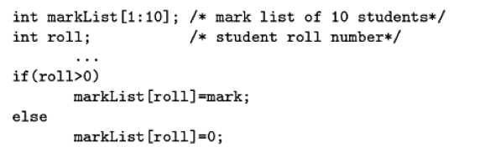
Example 10.3 Give an example of a program error that may not cause any failure.
Answer:
if the variable roll assumes zero or some negative value then an array index out of bound type of error would result. However, roll no normally takes positive values. Then, the else clause is unreachable and no failure would occur.
Thus, even if an error is present in the code, it does not show up as an error since it is unreachable for normal input values.

Slide 8
Relationship…
Mistake
Mistake is the cause and Error is its effect
Creates
Error/ Fault/ Bug/ Defect
Causes
Failure
Fault/ Error is a condition that causes a system to fail in performing its required function

Slide 9
Can a designer’s mistake give rise to a program error? Give an example
Answer:
Yes, a designer’s mistake give rise to a program error.
For example, a requirement might be overlooked by the designer, which can lead to it being overlooked in the code as well.
Error, fault, bug, defect are considered as synonyms and are used interchangeably by the program testing community

Slide 10
How Do You Test a Program?
Input test data to the program.
Test Suite Design
Observe the output: Run test cases and observe results to detect failures.
Check if the program behaved as expected
If the program does not behave as expected:
Note the conditions under which it failed.
Later debug to locate errors
Correct errors

Slide 11
Test scenario, Test Case
Test Scenario is made up of two words (Test & Scenario). Where Test means to verify or validate, and Scenario means any user journey. When combined it says verify user journey. Test all possible usages of the system that may be performed by any user.
It is also called Test Condition or Test Possibility
A test case is said to be an implementation of a test scenario
Most of the times people get confused with the term Test Scenario & Test Case.
Test Scenario is what to be tested and a Test Case is how to be tested.
A test case is said to be a positive test case if it is designed to test whether the software correctly performs a required functionality.
A test case is said to be negative test case, if it is designed to test whether the software carries out something, that is not expected from the system.

Slide 12
Test scenario, Test Case
Please take a look at the difference between Test Scenario and Test Case
Example
Test Scenario: Validate the login page
Test Case 1: Enter a valid username and password
Test Case 2: Reset your password
Test Case 3: Enter invalid credentials
A positive test case can be designed to check if a login system validates a user with the correct user name and password.
A negative test case in this case can be a test case that checks whether the login functionality validates and admits a user with wrong or bogus login user name or password.

Slide 13
Test cases and Test suites
A software is tested using a set of carefully designed test cases:
The exhaustive set of all test cases is called the test suite
A test case is a triplet [I,S,O]
I is the data to be input to the system,
S is the state of the system at which the data will be input
The state of a program is also called its execution mode.
The text editor can at any time during its execution assume any of the following execution modes—create, edit, and view
O is the expected output of the system.

Slide 14
Testability
Testability of a requirement denotes the extent to which it is possible to determine whether an implementation of the requirement conforms to it in both functionality and performance.
In other words, the testability of a requirement is the degree to which an implementation of it can be adequately tested to determine its conformance to the requirement.

Slide 15
Example of testbility
Suppose two programs have been written to implement essentially the same functionality. How can you determine which of these is more testable?
Answer:
A program is more testable, if it can be adequately tested with lesser number of test cases.
Obviously, a less complex program is more testable.
The complexity of a program can be measured using several types of metrics such as number of decision statements used in the program.
Thus, a more testable program should have a lower structural complexity metric.

Slide 16
Failure mode & Equivalent failure
A failure mode of a software denotes an observable way in which it can fail.
For example, consider a railway ticket booking software that has three failure modes—
failing to book an available seat,
incorrect seat booking (e.g., booking an already booked seat),
System crash.
Equivalent faults denote two or more bugs that result in the system failing in the same failure mode.
For example, the following two faults in C language leads to a program crash.
division by zero
illegal memory access errors

Slide 17
Error Detection Techniques: Verification versus Validation
Verification is the process of determining:
Whether output of one phase of development conforms to its previous phase.
Coding phase should conform to design phase
Verification is concerned with phase containment of errors
Phase containment of errors means detect and correct the errors within the phase where it's actually live.
That is a design error should be detected and corrected within the design phase itself rather than detecting it in the coding phase.
For example, if a design problem is detected in the design phase itself, then the problem can be taken care of much more easily than if the error is identified, say, at the end of the testing phase. In the later case, it would be necessary not only to rework the design, but also to appropriately redo the relevant coding as well as the system testing activities, thereby incurring higher cost.
Verification does not require execution of the software, whereas validation requires execution of the software.

Slide 18
Verification versus Validation
Validation is the process of determining:
Whether a fully developed system conforms to its SRS document.
the aim of validation is that the final product be error free.
The activities involved in these two types of bug detection techniques together are called the “V and V” activities.
Error detection techniques = Verification techniques + Validation techniques

Slide 19
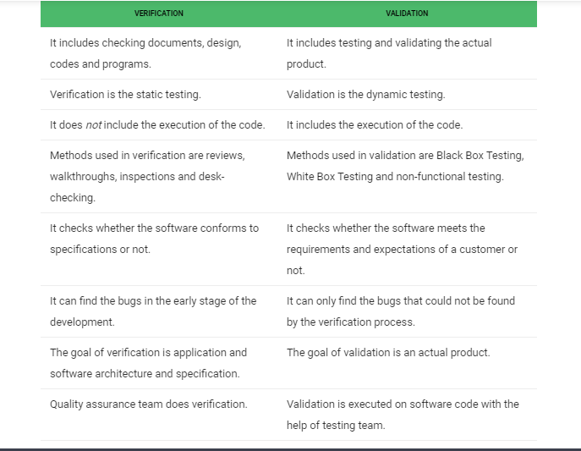
Difference between Verification and Validation

Slide 20
Example
Example 10.5 Is it at all possible to develop a highly reliable software, using validation techniques alone? If so, can we say that all verification techniques are redundant?
Answer: It is possible to develop a highly reliable software using validation techniques alone. However, this would cause the development cost to increase drastically. Verification techniques help achieve phase containment of errors and provide a means to cost-effectively remove bugs.

Slide 21
Activities performed in Testing
Test suite design:
The set of test cases using which a program is to be tested is designed possibly using several test case design techniques.
Running test cases and checking the results to detect failures:
Each test case is run and the results are compared with the expected results. A mismatch between the actual result and expected results indicates a failure.
Locate error:
The failure symptoms are analysed to locate the errors.
Error correction:
After the error is located during debugging, the code is appropriately changed to correct the error.

Slide 22
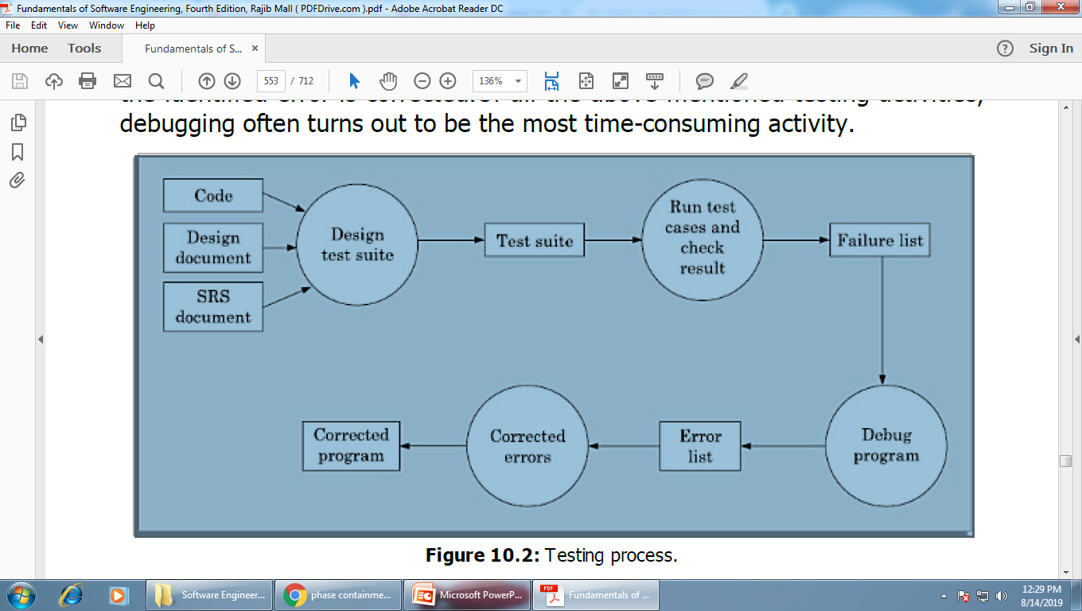
Activities performed in Testing

Slide 23
Design of Test Cases
Testing a system using a large number of randomly selected test cases:
Does not mean that many errors in the system will be uncovered.
Consider following example:
Find the maximum of two integers x and y. The code has a simple programming error:
If (x>y) max = x; else max = x;
Test suite {(x=3,y=2);(x=2,y=3)} can detect the error,
A larger test suite {(x=3,y=2);(x=4,y=3); (x=5,y=1)} does not detect the error.

Slide 24
Design of Test Cases
Exhaustive testing of any non-trivial system is impractical:
Input data domain is extremely large.
Ex., testing with all possible combination of X, Y in the previous example
Design an optimal test suite:
Of reasonable size and
Uncovers as many errors as possible.
Systematic approaches are required to design an optimal test suite:
Each test case in the suite should detect different errors.

Slide 25
Design of Test Cases
There are essentially two main approaches to design test cases:
Black-box approach
White-box (or glass-box) approach

Slide 26
Black-Box approach
Test cases are designed using only functional specification of the software:
Without any knowledge of the internal structure of the software.
Black- box test cases are designed solely based on the input-output behaviour of a program.
For this reason, black-box testing is also known as functional testing.

Slide 27
White-box Testing
Designing white-box test cases:
Requires knowledge about the internal structure of software.
white-box test cases are based on an analysis of the code.
White-box testing is also called structural testing.
These two approaches of test case design are complementary.
That is, a program has to be tested using the test cases designed by both the approaches, and one testing using one approach does not substitute testing using the other.

Slide 28
Black Box Testing

Slide 29
Black-Box Testing
There are essentially two main approaches to design black box test cases:
Equivalence class partitioning
Boundary value analysis

Slide 30
Equivalence Class Partitioning
Input values to a program are partitioned into equivalence classes.
Partitioning is done such that:
Program behaves in similar ways to every input value belonging to an equivalence class.
Why Define Equivalence Classes?
Test the code with just one representative value from each equivalence class:
As good as testing using any other values from the equivalence classes.

Slide 31
Equivalence Class Partitioning
How do you determine the equivalence classes?
Examine the input and output data.
If the input data to the program is specified by a range of values:
One valid and two invalid equivalence classes are defined.
Equivalence class with Invalid range of values
Equivalence class with Valid Range of Values
Equivalence class with Invalid range of values
Age validation (suppose valid range 25-45)
<25
25-45
>45
Mobile number validation (must be exactly 10 digits)
A number
With < 10 digit
A 10 digit number
A number
With >10 digit

Slide 32
Example
A program reads an input value in the range of 1 and 5000 and computes the square root of the input number
There are three equivalence classes:
The set of negative integers,
Set of integers in the range of 1 and 5000,
Integers larger than 5000.
The test suite must include:
Representatives from each of the three equivalence classes:
A possible test suite can be: {-5,500,6000}.

Slide 33
Equivalence Class Partitioning
If input is an enumerated set of values:
e.g. {a,b,c}and each letter is treated uniformly then
There will be two equivalence classes
One equivalence class for valid input values.
Another equivalence class for invalid input values should be defined.
Input validation (must belong to the set {a,b,c})
Any letter other than {a,b,c}
Any letter from the set {a,b,c}

Slide 34
Equivalence Class Partitioning
If input is an enumerated set of values:
e.g. {car, bus, train}and each member of the set is treated differently then
There will be three equivalence classes for three distinct valid value
Valid equivalence class 1 - {car}
Valid equivalence class 2 - {bus}
Valid equivalence class 3 - {train}
Invalid equivalence class – {elephant}

Slide 35
Example 1 Design the equivalence class test cases for a program that reads two integer pairs (m1, c1) and (m2, c2) defining two straight lines of the form y=mx+c. The program computes the intersection point of the two straight lines and displays the point of intersection.
Answer: The equivalence classes are the following:
• Parallel lines (m1=m2, c1≠c2)
• Intersecting lines (m1≠m2)
• Coincident lines (m1=m2, c1=c2)
Now, selecting one representative value from each equivalence class, we get the required equivalence class test suite {(2,2)(2,5),(5,5)(7,7), (10,10) (10,10)}.

Slide 36
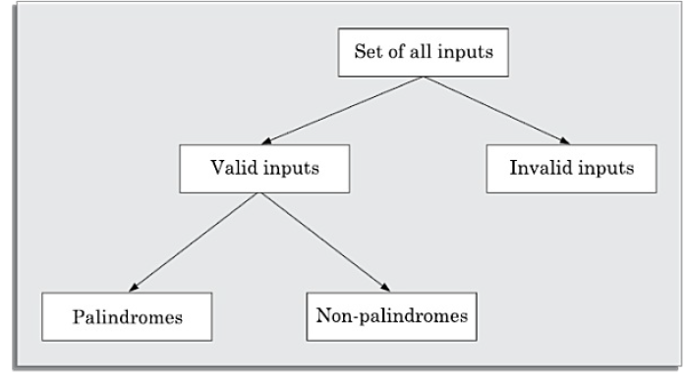
Example 2 Design equivalence class partitioning test suite for a function that reads a character string of size less than five characters and displays whether it is a palindrome.
Answer: The equivalence classes are the leaf level classes shown in Figure 10.4.
The equivalence classes are palindromes, non-palindromes, and invalid inputs (> = 5 characters). Now, selecting one representative value from each equivalence class, we have the required test suite: {abc,aba,abcdef}.
Set of all strings
Set of all strings
Length<5
Set of all strings
Length>=5
Set of all strings
Length<5 and is a palindrome
Set of all strings
Length<5and is not a palindrome

Slide 37
Boundary Value Analysis
Some typical programming errors occur:
At boundaries of equivalence classes
Programmers often fail to see:
Special processing required at the boundaries of equivalence classes.
Programmers may improperly use < instead of <=
Boundary value analysis:
Select test cases at the boundaries of different equivalence classes.

Slide 38
Example
For a function that computes the square root of an integer in the range of 1 and 5000:
Test cases must include the values: {0,1,5000,5001}.
1
5000

Slide 39
Example
Design equivalence class partitioning (considering boundary value) test suite for a function that reads a character string of size less than five characters and displays whether it is a palindrome.
Earlier we have the required test suite: {abc,aba,abcdef}.
Since there is a boundary between the valid and invalid equivalence classes. Thus, the boundary value test suite is {abcdefg, abcde}.
Set of all strings
Set of all strings
Length<5
Set of all strings
Length>=5
Set of all strings
Length<5 and is a palindrome
Set of all strings
Length<5and is not a palindrome

Slide 40
steps in the black-box test suite design approach:
Examine the input and output values of the program.
Identify the equivalence classes.
Design equivalence class test cases by picking one representative
value from each equivalence class.
Design the boundary value test cases as follows.
Examine if any equivalence class is a range of values. Include the values at the boundaries of such equivalence classes in the test suite.

